Slide 1

Meta Analysis
Bioinformatics Project
MazalTov Marouani
Anna Cohen
Sterna Farouz
Dr Zohar Barnett Itzhaki
Dr Moshe Amitay

Slide 2
Goal of the Research
We are going to analyse DATA composed of experiments on different tissues.
The number of samples can be significantly increased by including several experiments,
thus conducting a more in-depth study, which may reveal phenomena that were difficult to detect in a single experiment,
And reinforce significantly the statistics about differential expression of gene in the organism for regulatory decision making.

Slide 3
Research Question
What can Meta Analysis tell us more about the effects of TCDD on living organisms?

Slide 4
TCDD - 2,3,7,8-Tetrachlorodibenzodioxin
Most toxic dioxin compound.
In 1997, it was classified as carcinogen for humans.
Lipophilics : very stable in living organism.
Resistant to detoxification mechanisms.
Remain stored in the adipose tissue of animals .

Slide 5
Procedure to find our articles
TCDD or BPA ?
Experiment Type
Treatment Protocol
Which Organism ?
We worked on 6 studies :
one of them was not published
Two were on the same article
So we stay with 4 articles :
one on femoral cells
two on intestinal epithelium cells
two on hepatic cells

Slide 6
AHR Aryl Hydrocarbon Receptor
Transcription Factor that regulates gene expression.
Regulator of enzymes such as cytochrome P450s that metabolize these chemicals.
Roles in regulating immunity, stem cell maintenance, and cellular differentiation.
Normally inactive.
Upon ligand binding to chemicals such as TCDD, it leads to changes in gene transcription.
Notes:
mazal

Slide 7
2,3,7,8-Tetrachlorodibenzo-p-dioxin dose-dependently increases bone mass and decreases marrow adiposity in juvenile mice.
2,3,7,8-Tetrachlorodibenzo-p-dioxin (TCDD)-elicited effects on bile acid homeostasis: Alterations in biosynthesis, enterohepatic circulation, and microbial metabolism.
Convergence of Hepcidin Deficiency, Systemic Iron Overloading, Heme Accumulation, and REV-ERBα/β Activation in Aryl Hydrocarbon Receptor-Elicited Hepatotoxicity.
RNA-Seq versus oligonucleotide array assessment of dose-dependent TCDD-elicited hepatic gene expression in mice

Slide 8
Convergence of the 4 articles: TCDD perturbes
Cytochrome P450
Bile acid homeostasis
Lipid metabolism
Iron homeostasis
Heme metabolism
Extracellular matrix remodeling
Antioxidant defenses

Slide 9
Preparing the DATA for the Comparisons
Selection of the data according to the dosage of TCDD in order to compare.
We have selected three dosages : 0, 0.3 and 30 microg/kg
Therefore we will do 3 comparisons:
0vs03
0vs30
03vs30
For the 3 comparisons, we need :
Count.txt
Gene ID
Length
Counts of the SRR
Experimental Design.txt
Sample Accession
Cell
Treatment
Study

Slide 10
How do we got the DATA to work ?
To get the counts, we used 4 scripts:
Prefetch
Input : name of SRR
Download a SRA file
RunFastq
Transform the SRA file
to a Fastq file
Runner
Make Alignement with the help of STAR
Get a SAM file
Features Count
Make the Count on the SAM file
Get a TXT file with number of Reads for each Gene for each SRR

Slide 11


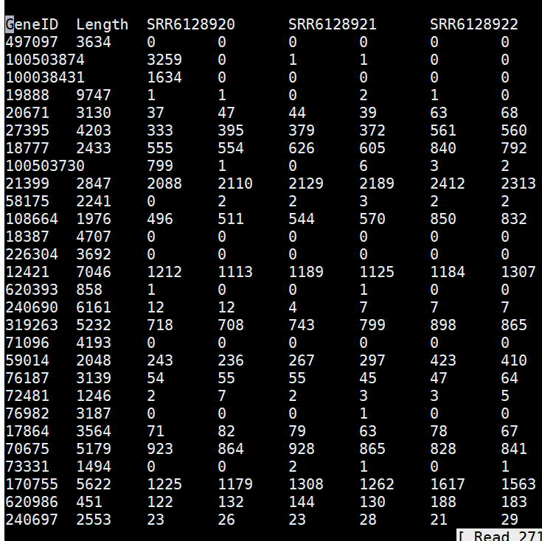
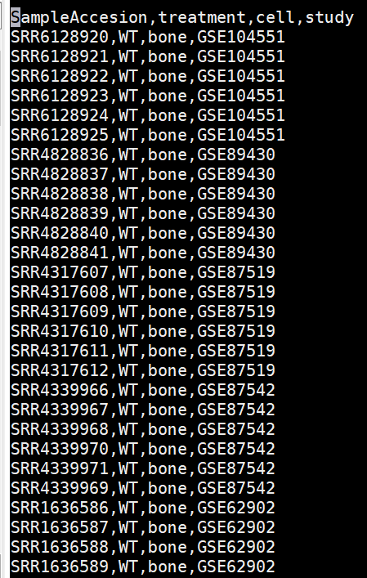
Little prewiew of our files
Counts File
Experimental Design File

Slide 12
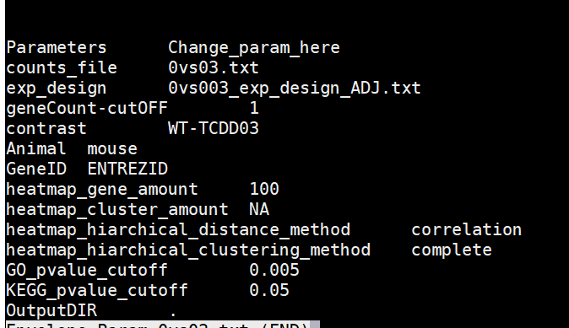
Comparison with PIPE
We prepared a TXT file which contains the parameters
We run RNAseq_Analysis which contains 4 other scripts
Notes:
faire un flow interieur

Slide 13
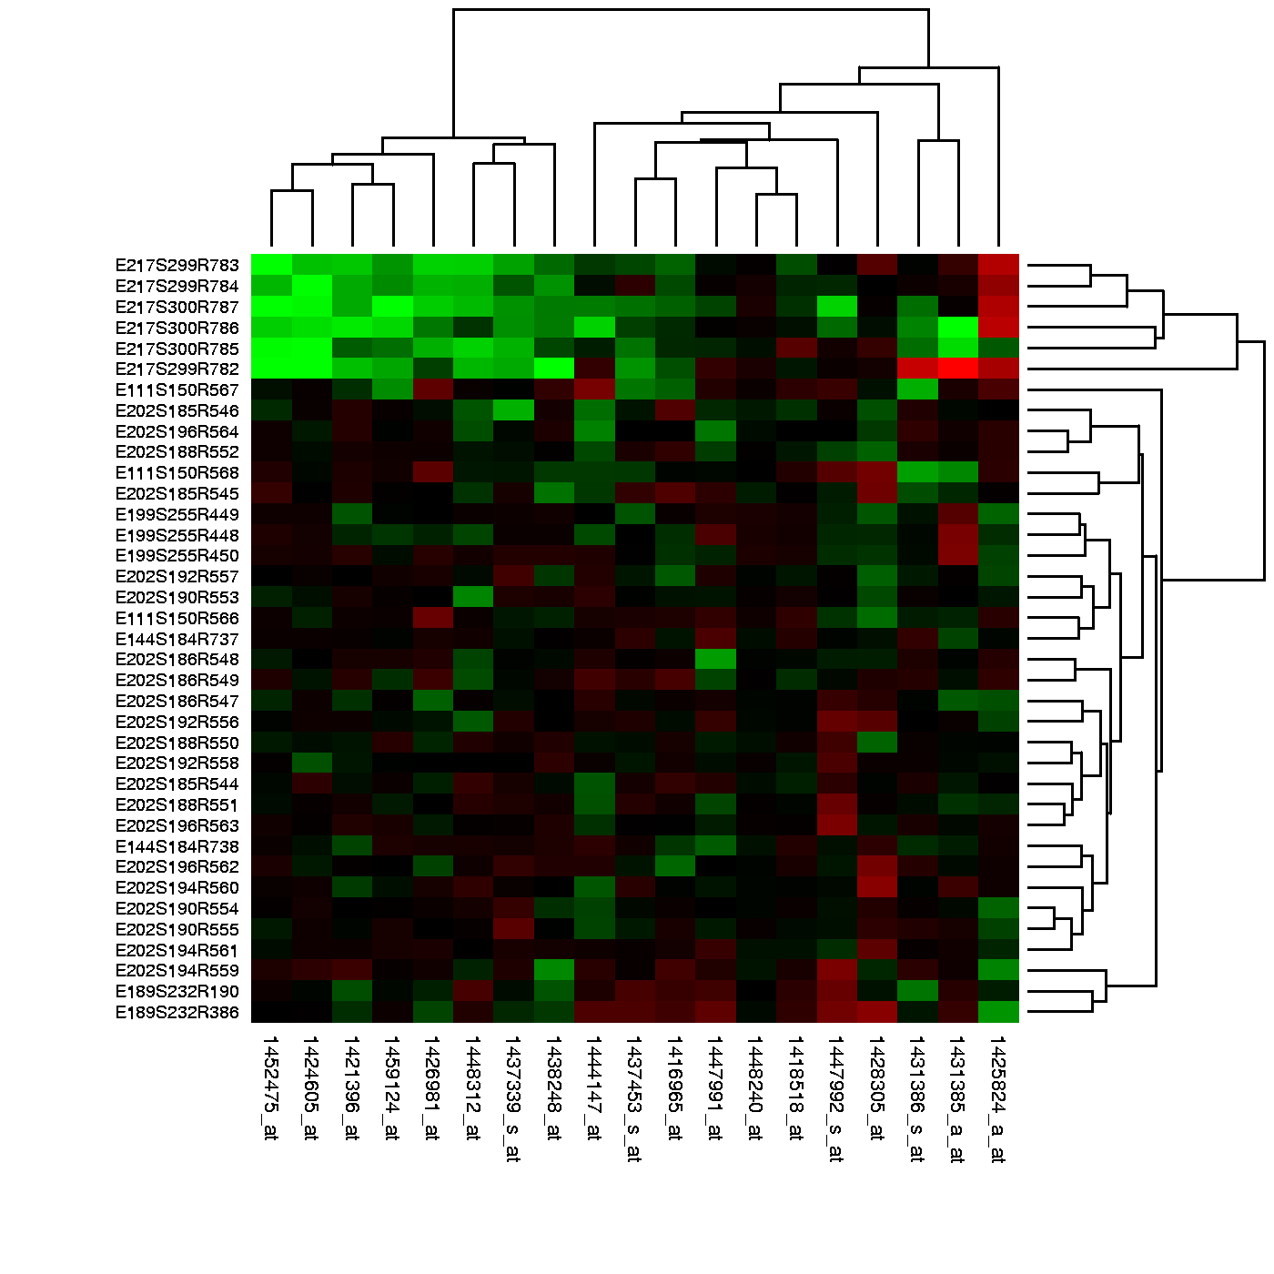
RNAseq Analysis
P-val Summary Improve
The script calculates for each gene P-value and other values that help the researcher to decide which gene behaved differently in the cells that were "treated".
Make Heat Map
The script performs heatmap and hierarchy clustering to RNA-Seq study.

Slide 14
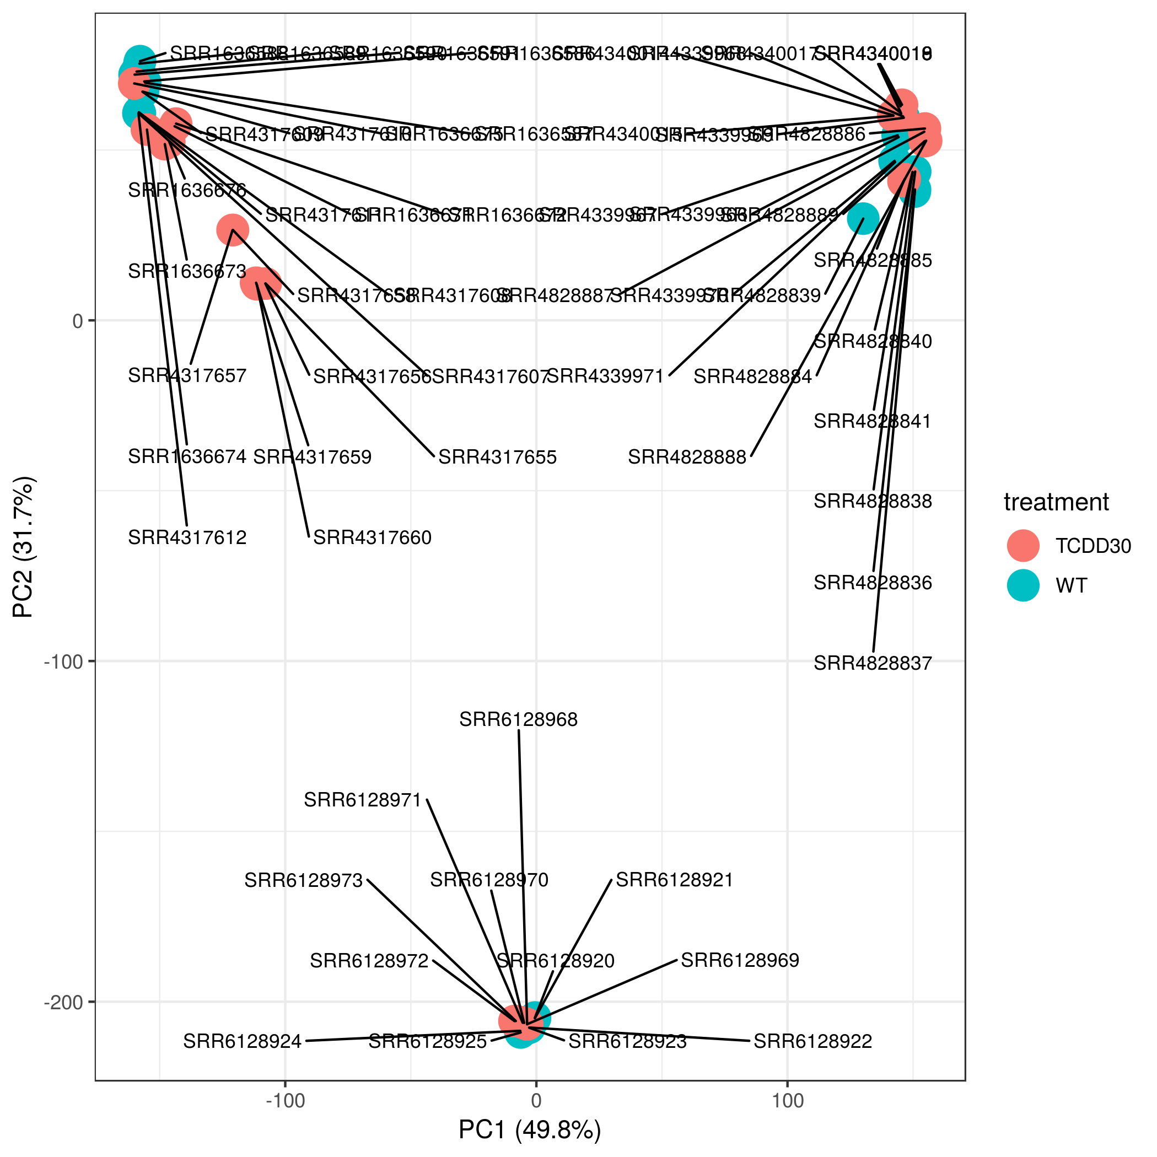
RNAseq Analysis
Make_PCA
The script gets counts file and the contrast and returns a file with data for PCA chart.That help the researcher to see the relative distance between the samples or groups
EnrichmentGOKEGG
The script get a list of gene that are up reglated under certain conditions, and it will find which GO terms are over or under represented using a annotation for that gene set

Slide 15
Analysis of the Results
Our comparative RNAseq Analysis is based on :
HeatMap : Differential gene expression for each comparison.
Enrichment :Give the common function of a genes cluster.

Slide 16
PCA
Clusters of the samples according to the tissues.

Slide 17
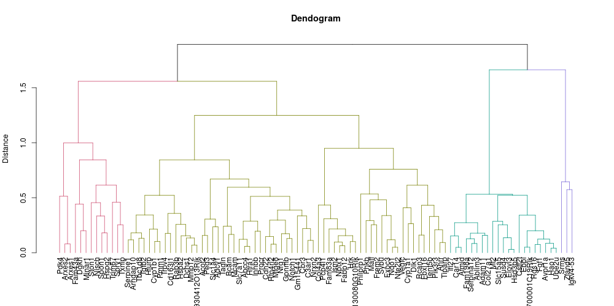
Clusters – group of genes that have the same behavior

Slide 18
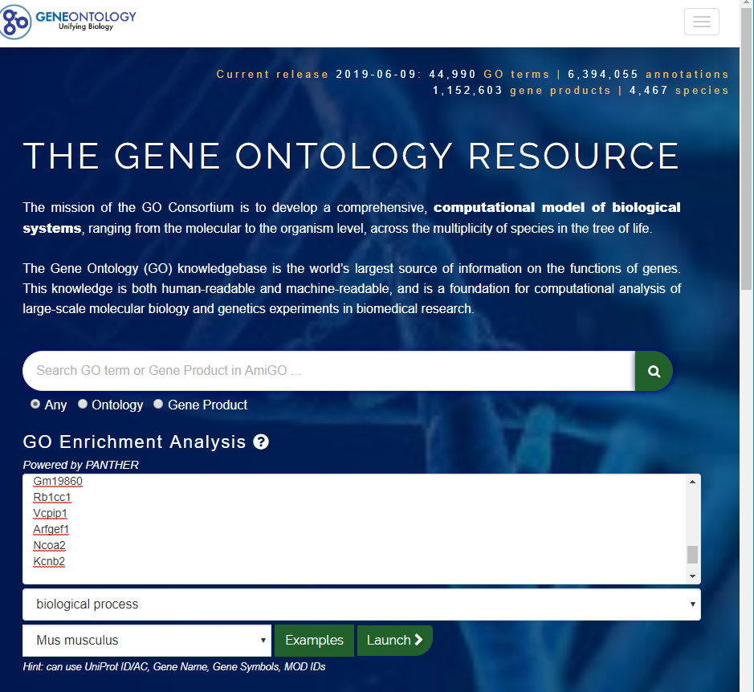
Enrichment
For each comparisons , we had 4 clusters:
We made Enrichment for each Cluster, in order to find common biological function.

Slide 19
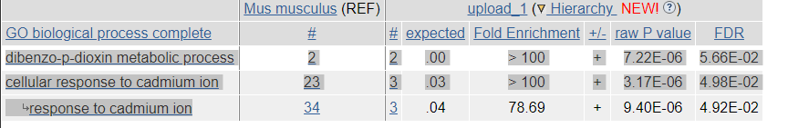
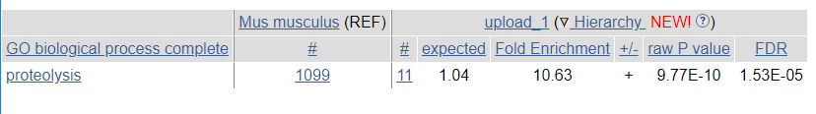
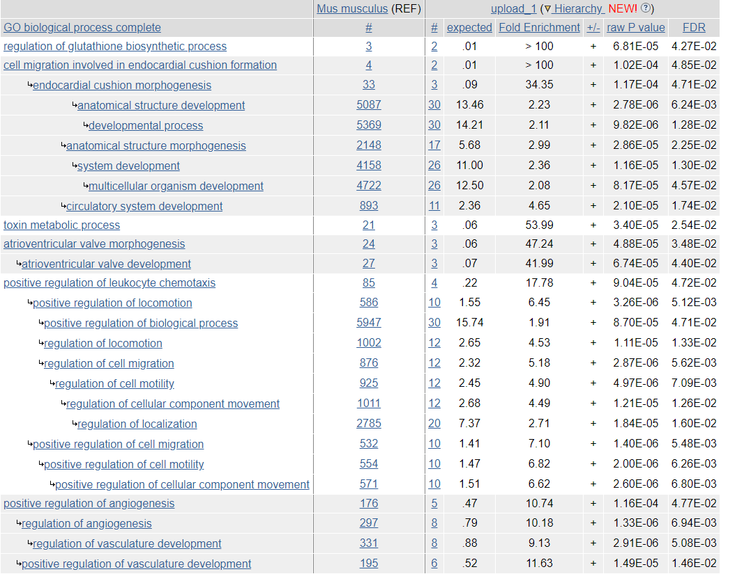
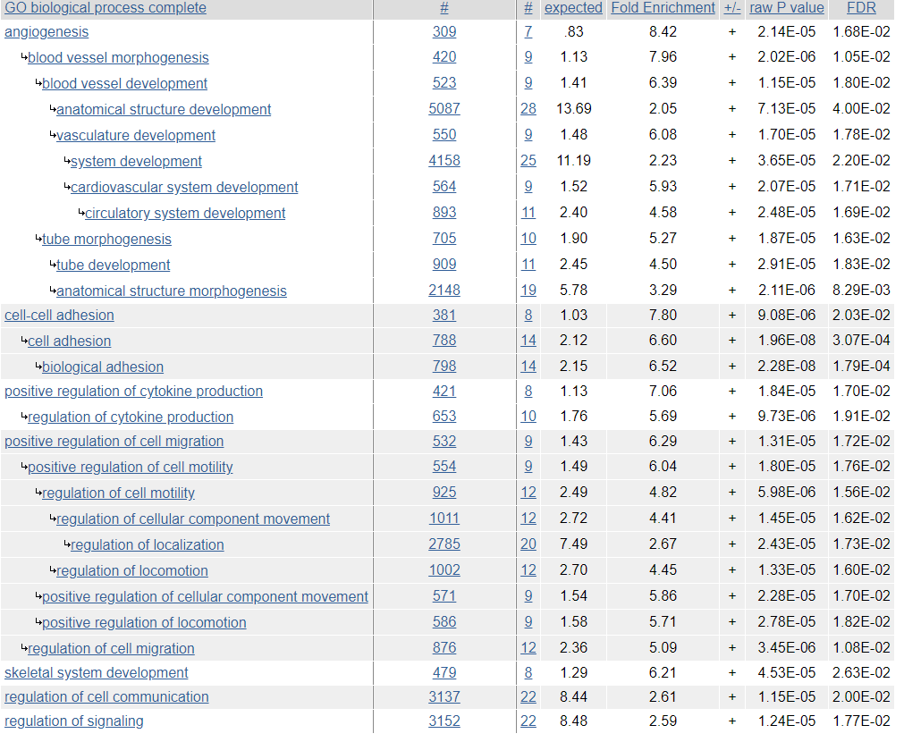
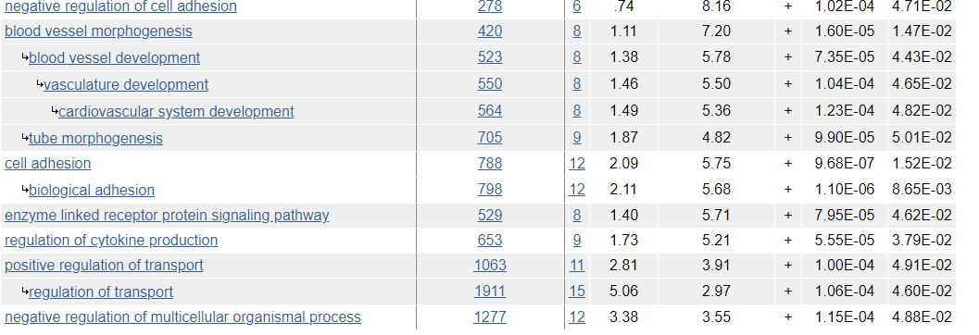
0vs03
Cluster 1
Cluster 3
03vs30
Cluster 1
0vs03
Cluster 1

Slide 20
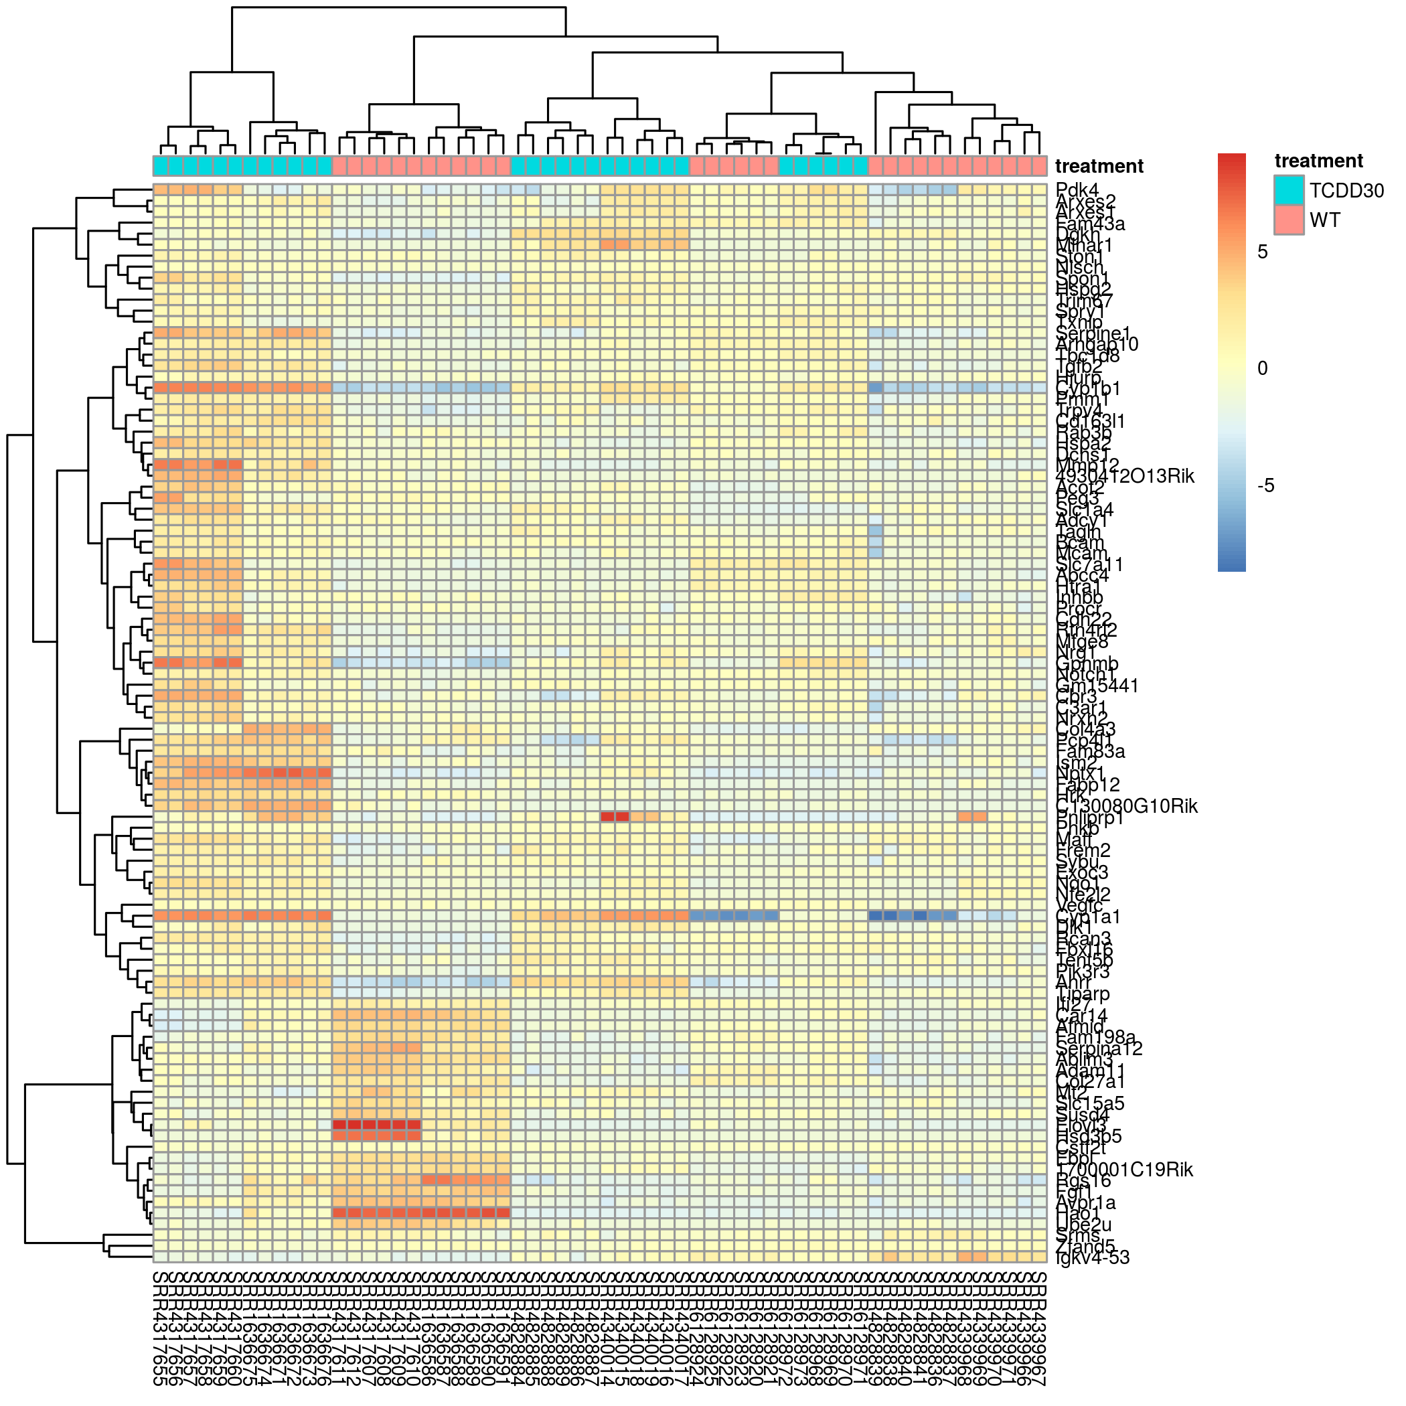
HeatMap
Enrichment : Cytochrome P450
CYP Genes are family of enzyme containing heme as a cofactor which are involved in the oxidation-reduction reactions of a large number of molecules.

Slide 21

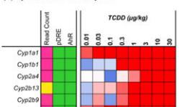
Gene Cyp1b1

Slide 22
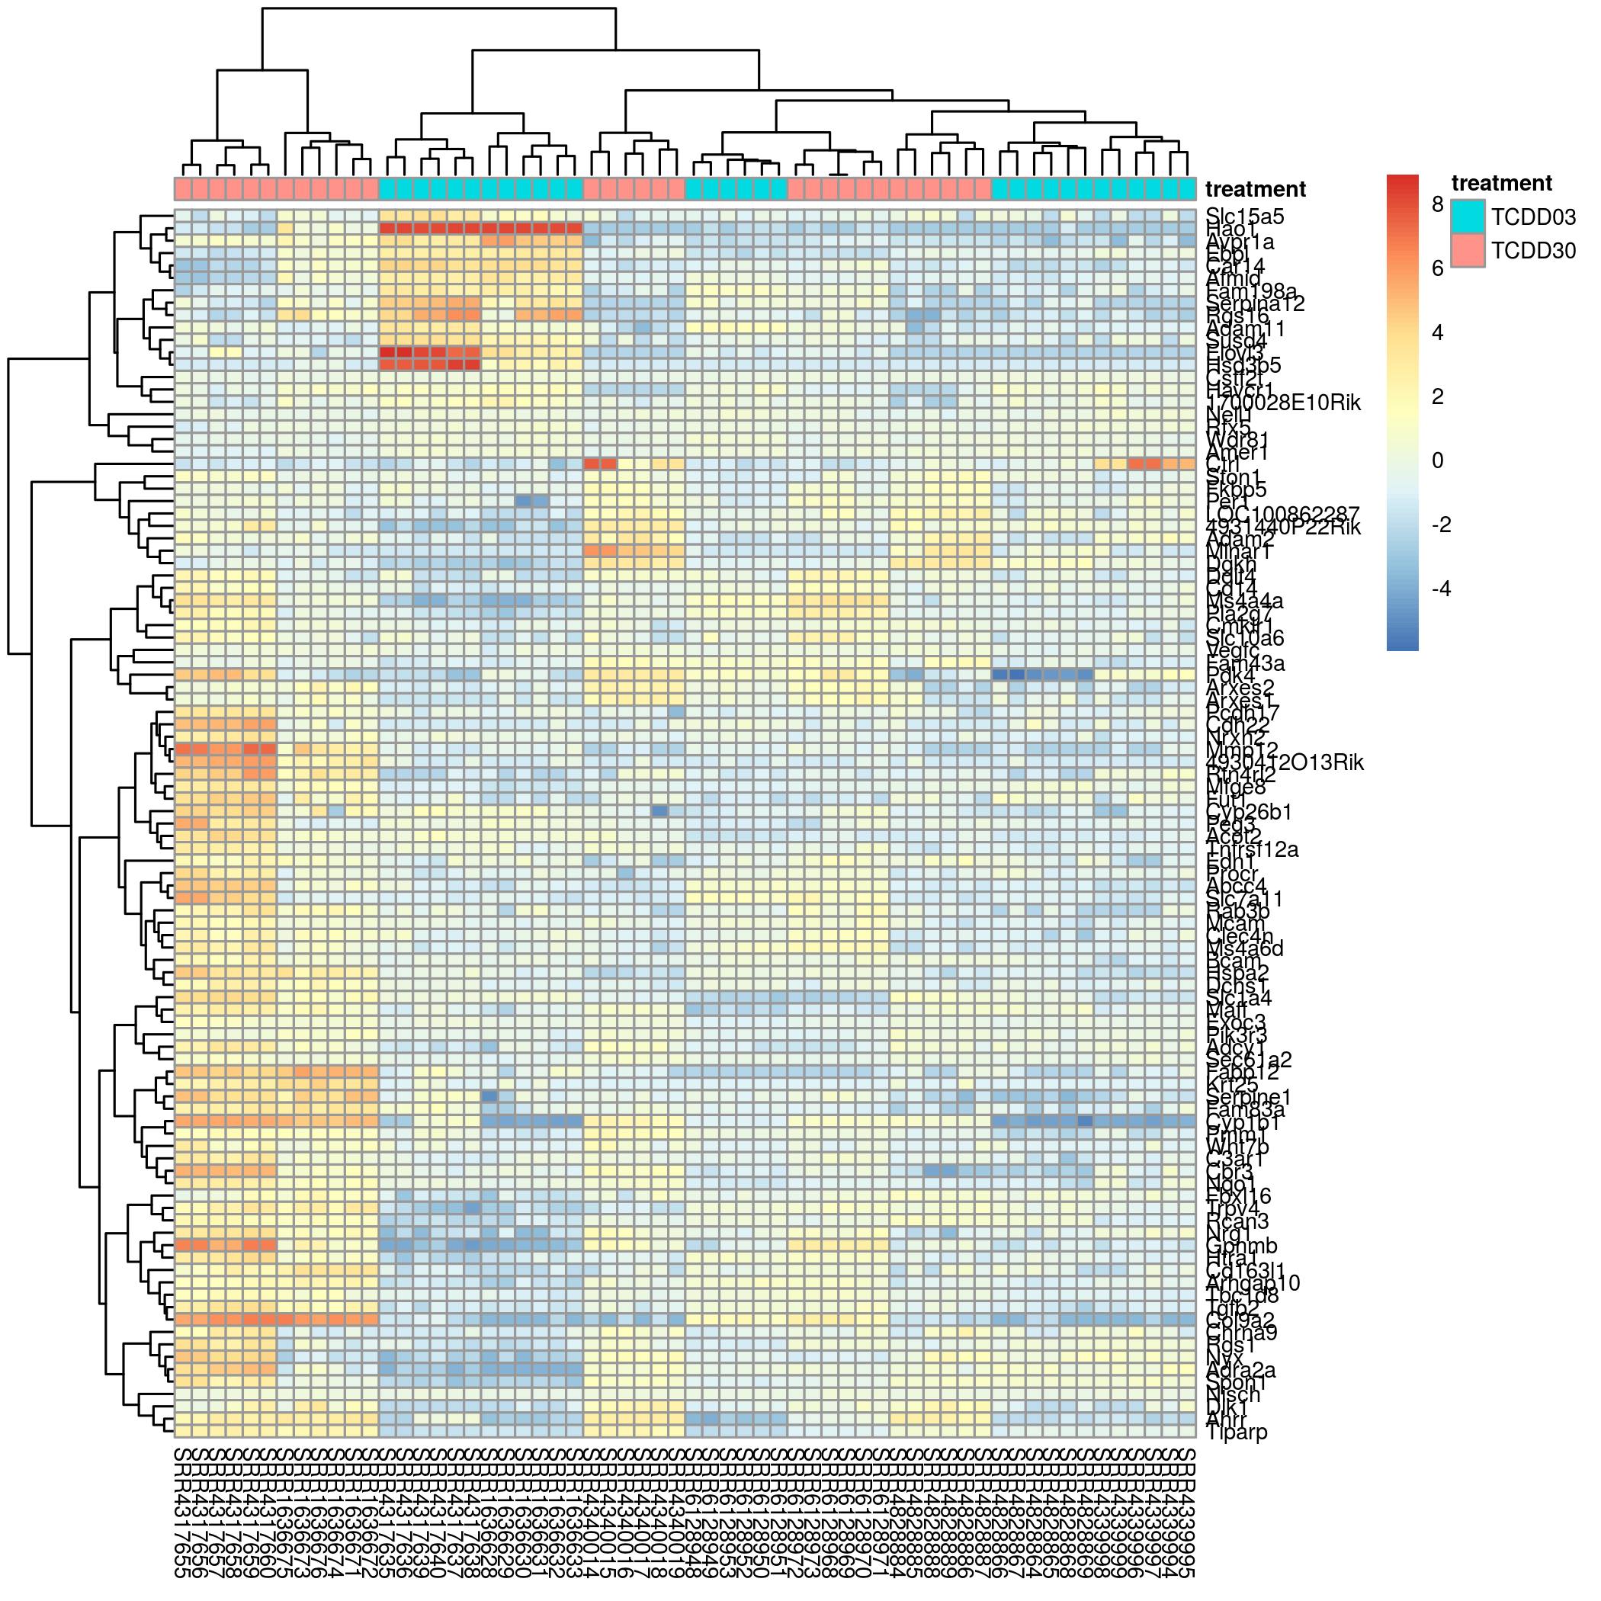
HeatMap
Gpnmb :The protein encoded by this gene is a transmembrane glycoprotein.
GPNMB has been reported to be expressed in various cell types, including: osteoblasts and dendritic cells, and it is overexpressed in various cancer types.
Enrichment Osteoblast Differentiation

Slide 23

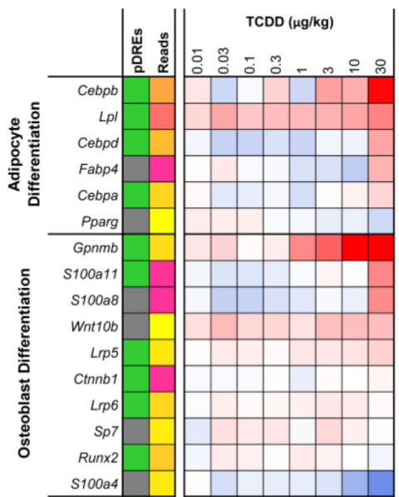
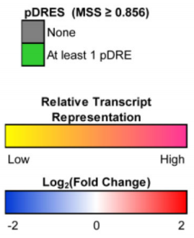
Gene Gpnmb

Slide 24
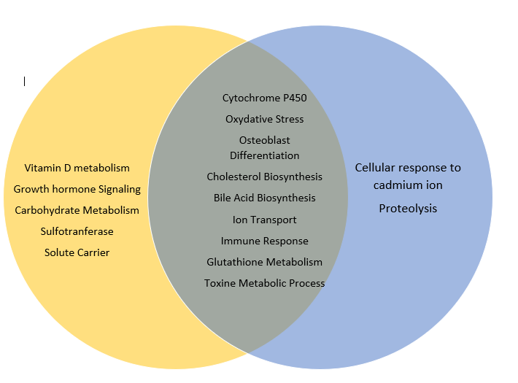
Enrichment Comparison
Articles Enrichment
Clusters Enrichment

Slide 25
Results Summary
We found 2 kinds of Results :
Same conclusion from the articles and the comparisons :
Cytochrome P450 and Osteoblast Differentiation.
The observation of the same behavior in genes allow us to find News Biological Process : Cellular response to cadmium ion.

Slide 26
Conclusion
By collecting the studies of interrest,
we have created a MetaData
which we carried out a comparative Analysis,
which enable us identify other biologocal processes affected by the TCDD,
than those that were known until then .

Slide 27
Thanks to
Moshe for the Scripts.
Zohar for all the explanations.
Hanna Drori for Avi Maayan Web Site.
Shira Zaltzman for the sequence Alignement on the Mouse Genome.

